Slide 1

SPITRACK
Simplifying Research Techniques

Slide 2

Team Members - Eccentrics
Mohammad Nabiluzzaman Neloy 1831251042 mohammad.nabiluzzaman@northsouth.edu
Rafid Ahmed 1831395642 rafid.ahmed@northsouth.edu

Slide 3
Organization

Slide 4
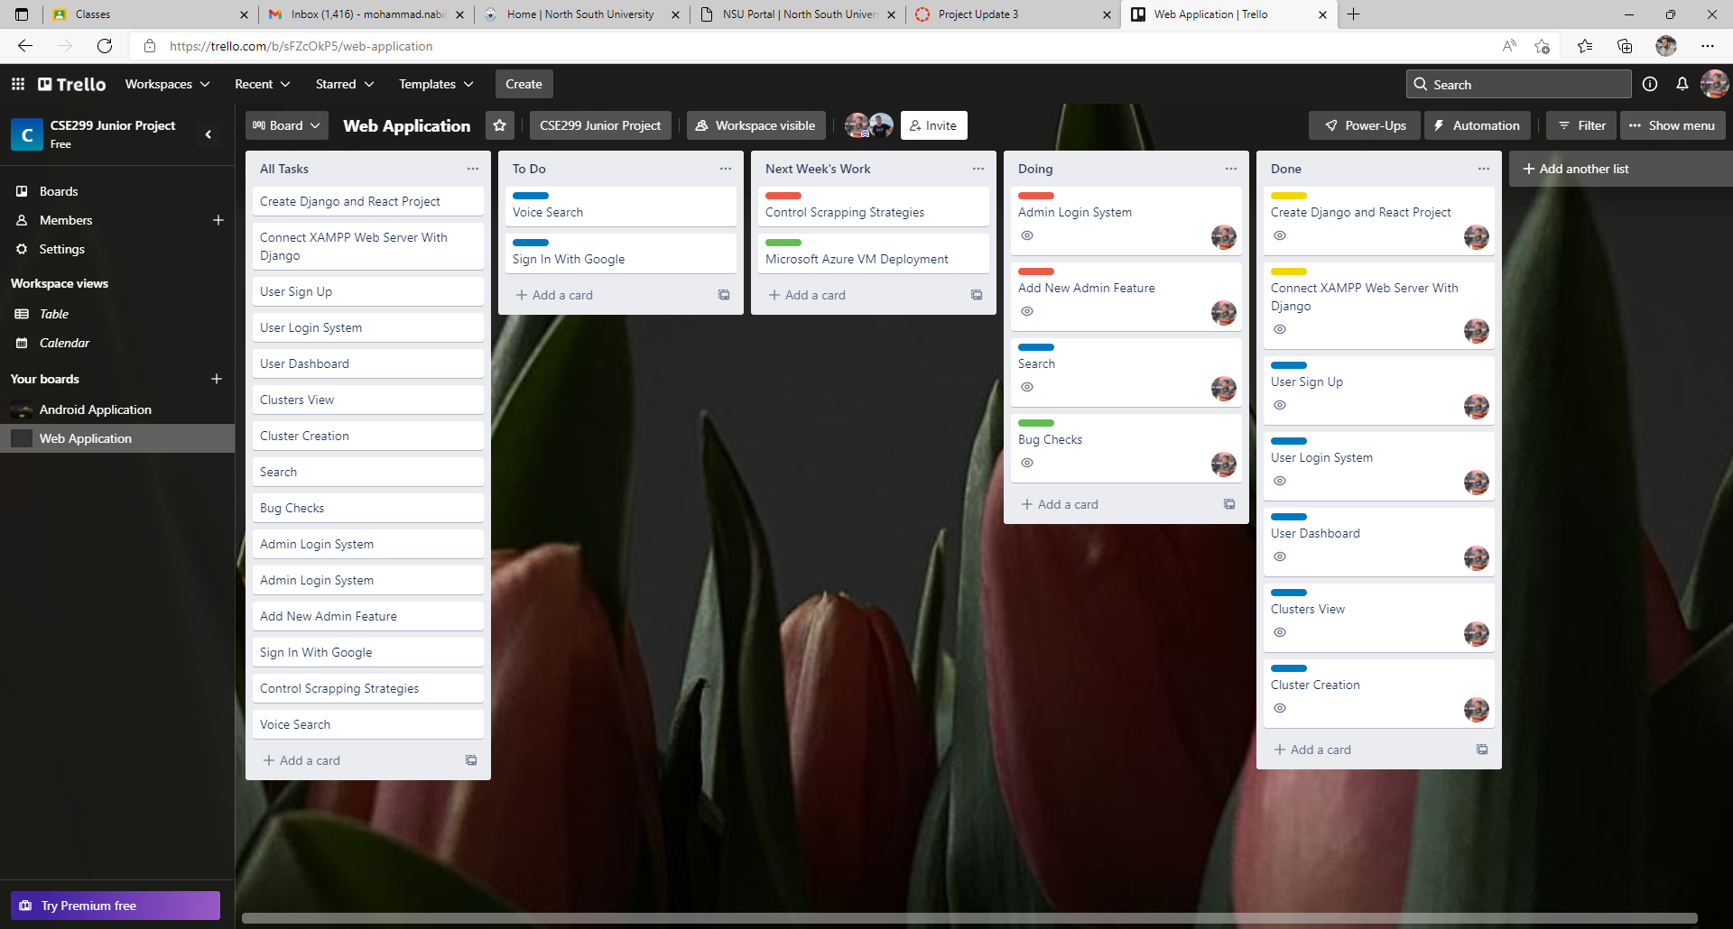
Web Application (Neloy): Trello Board

Slide 5
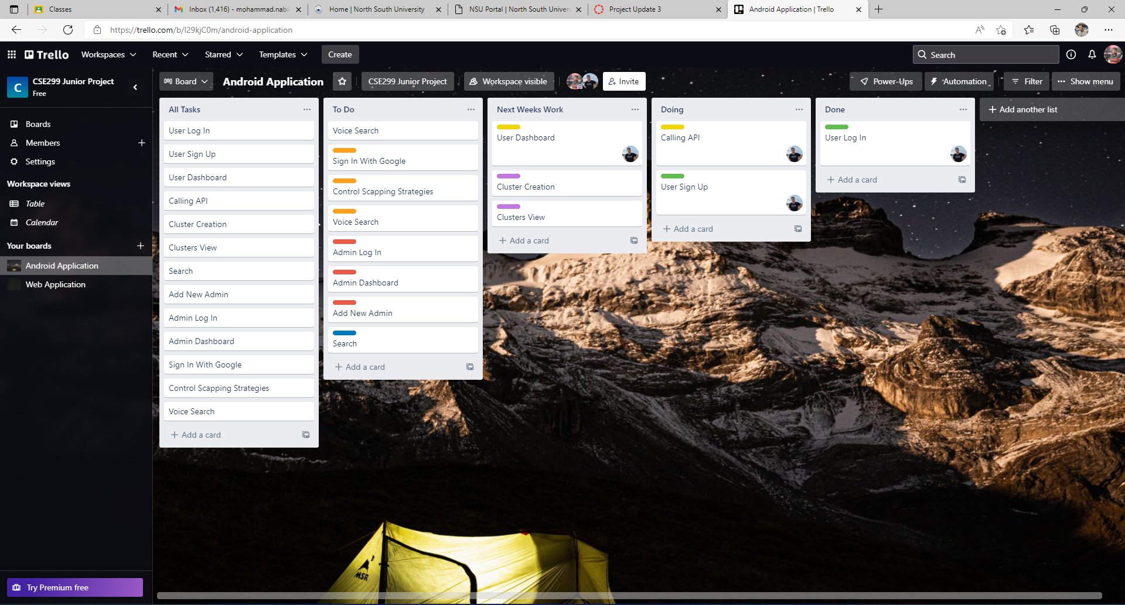
Android Application (Rafid): Trello Board

Slide 6
Communication

Slide 7
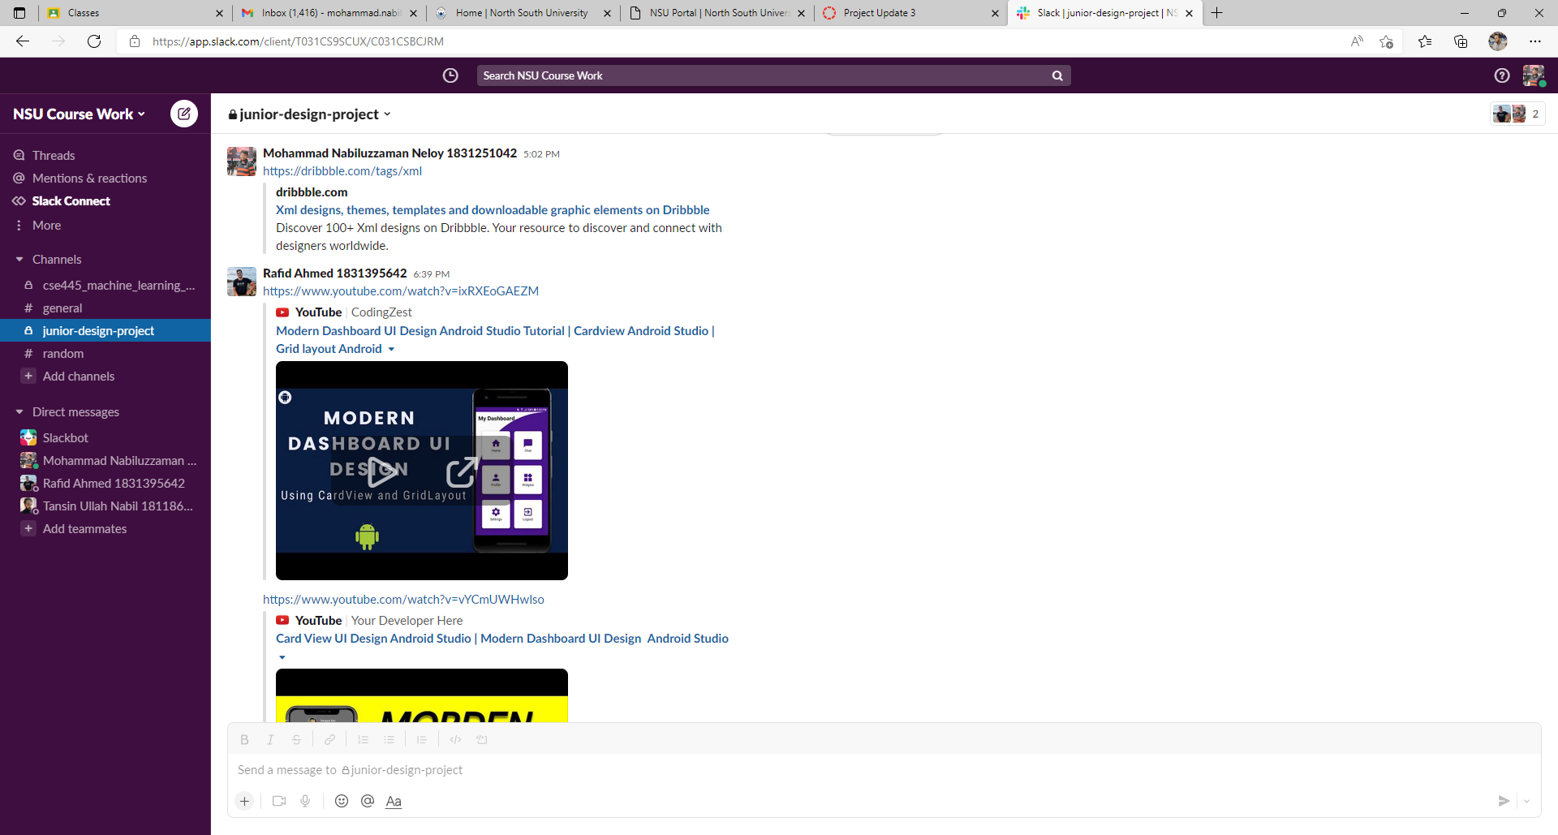

Slide 8
Work – WebApp (Neloy)

Slide 9
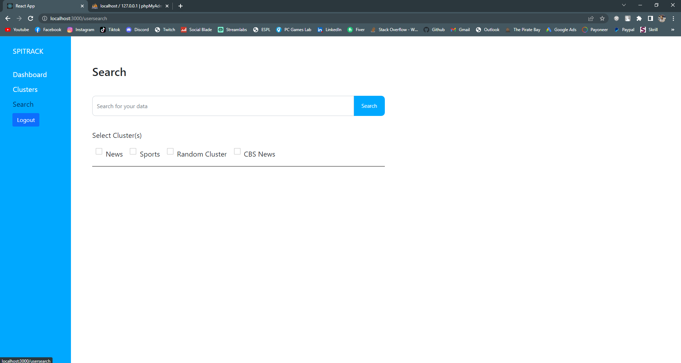
Web Application (Neloy): Search Window

Slide 10
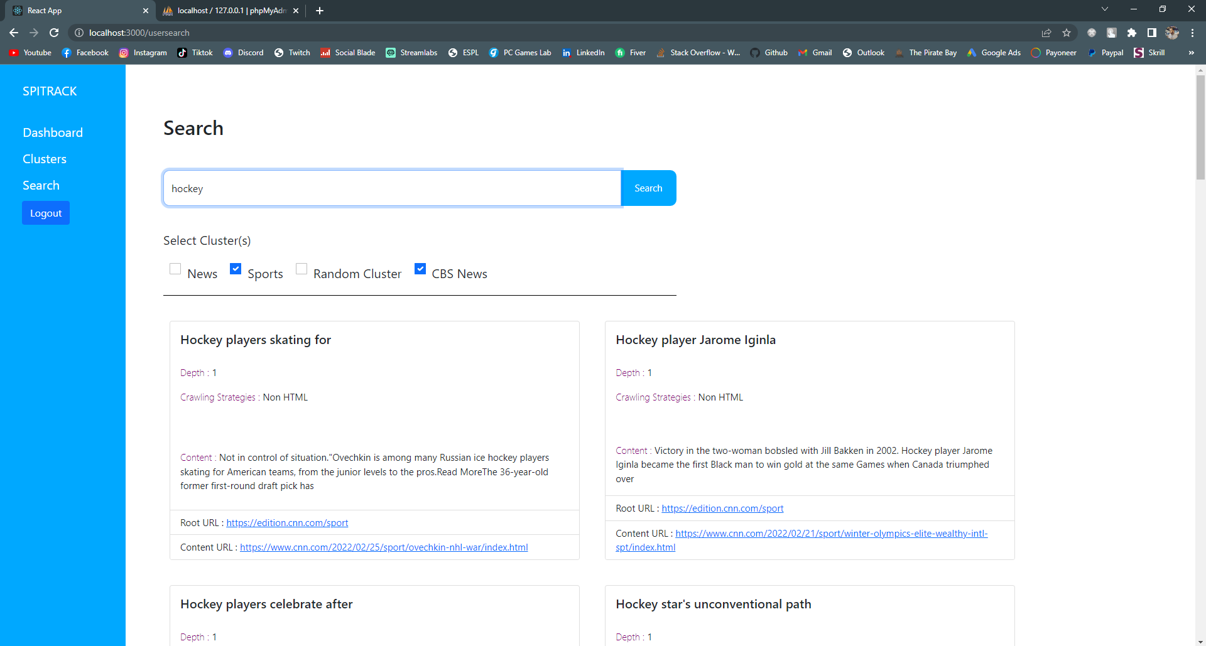
Web Application (Neloy): Search Results
Enter Keyword
Select Cluster

Slide 11
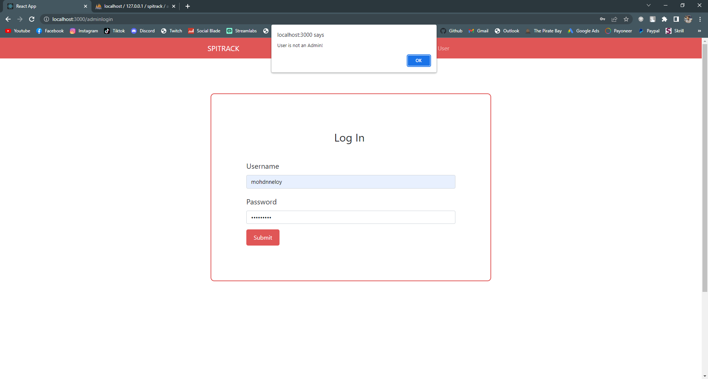
Web Application (Neloy): Admin Log In (Using User’s Username)

Slide 12
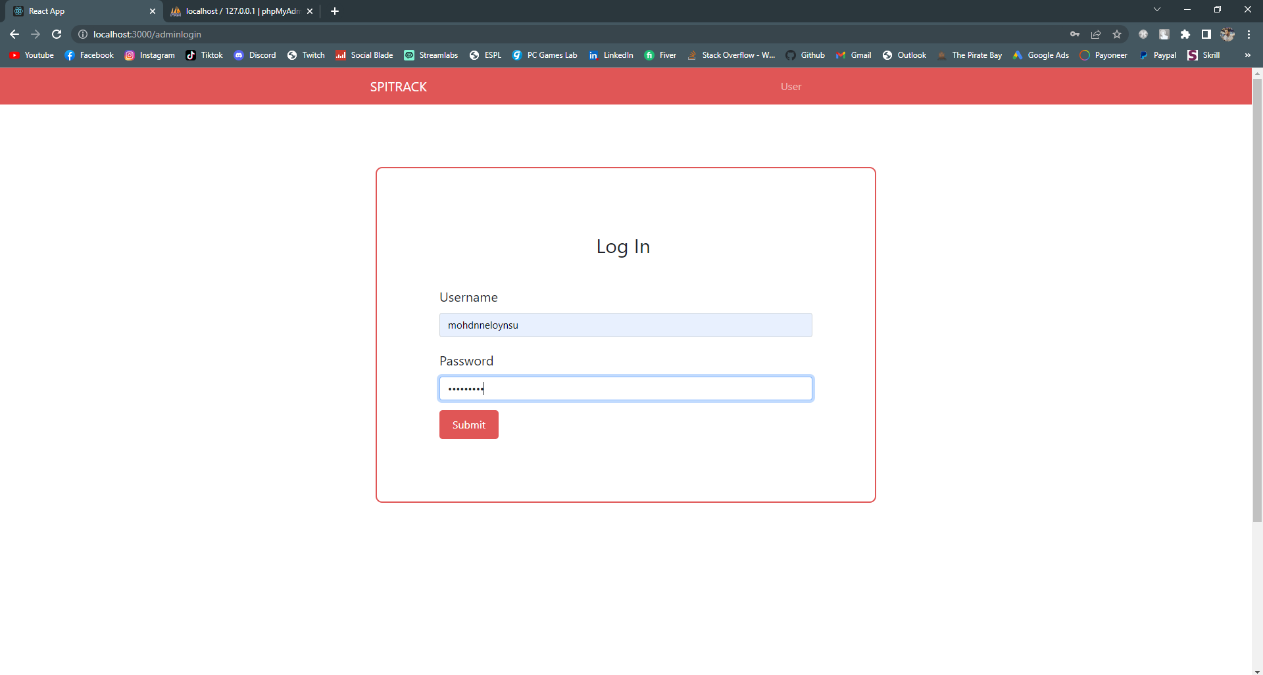
Web Application (Neloy): Admin Log In (Using Admin’s Username)

Slide 13
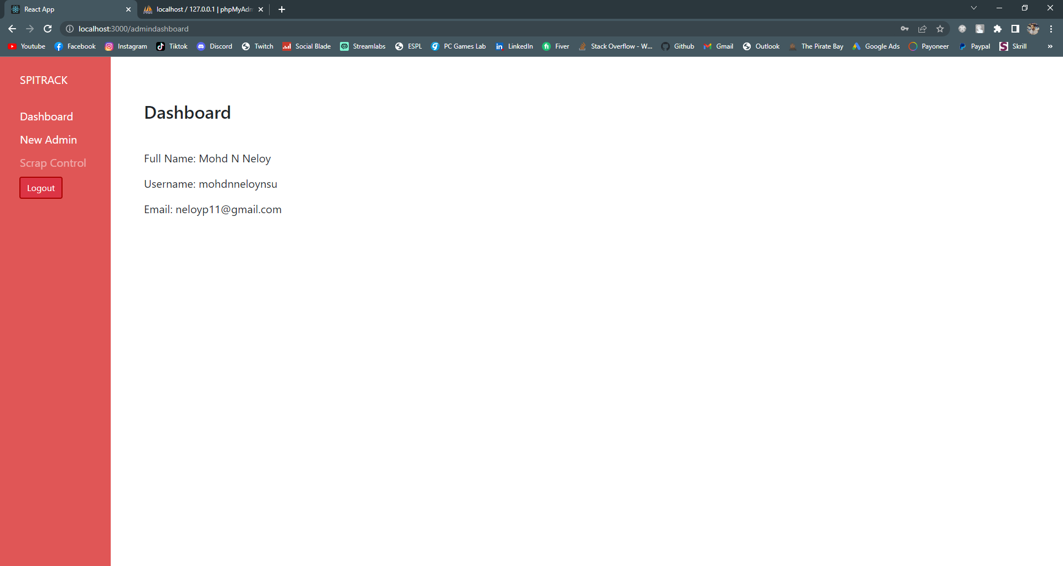
Web Application (Neloy): Admin Dashboard

Slide 14
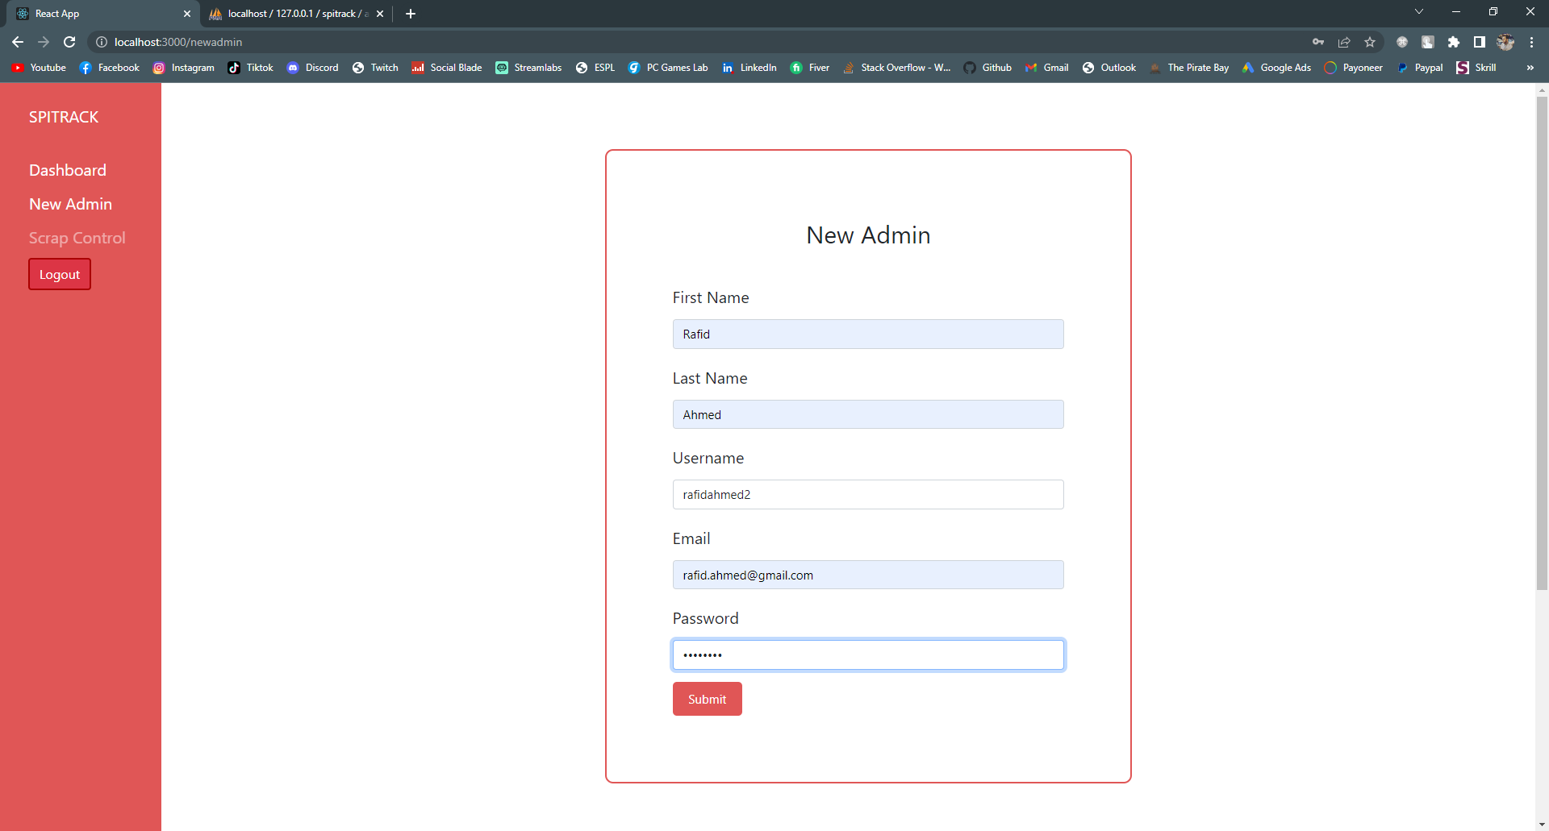
Web Application (Neloy): Add New Admin 1

Slide 15
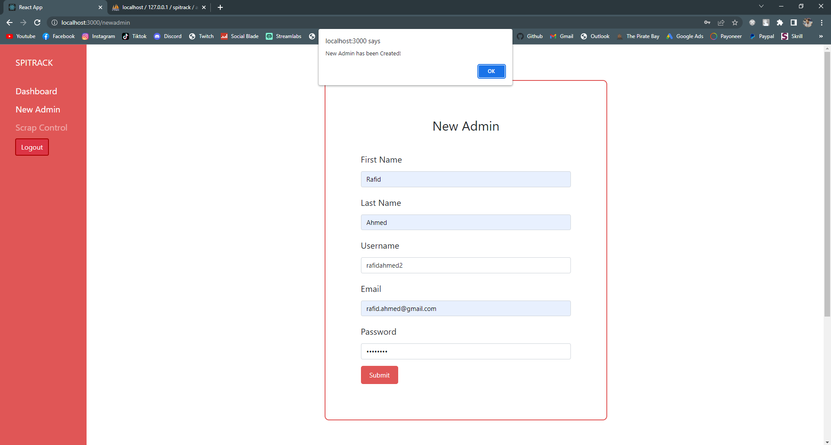
Web Application (Neloy): Add New Admin 2

Slide 16
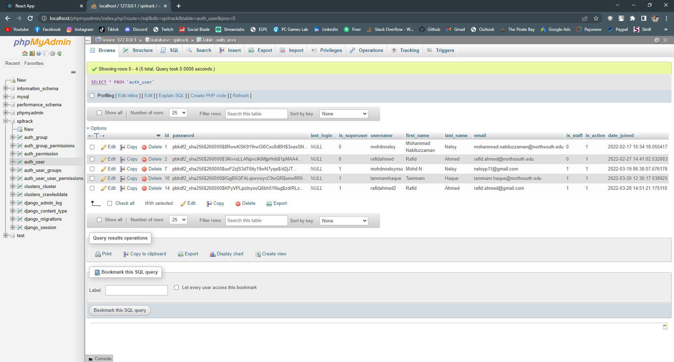
Web Application (Neloy): Add New Admin 3 (Database Update)
Admin = 1
User = 0

Slide 17
Work – Android App (Rafid)

Slide 18
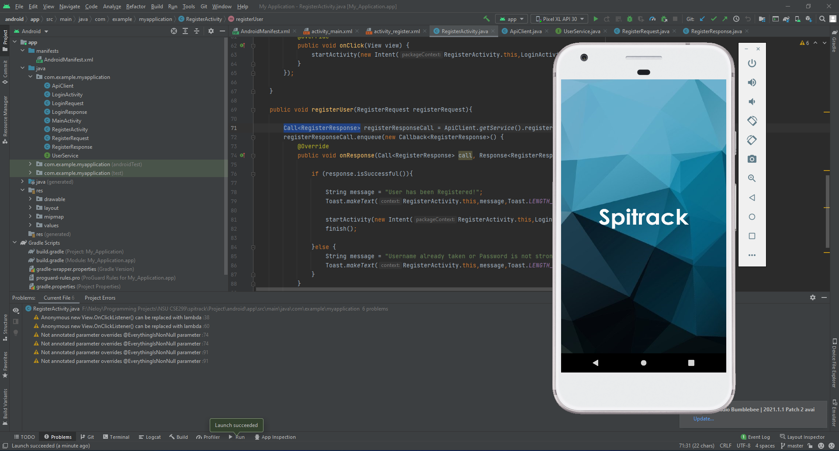
Android Application (Rafid): Splash Screen

Slide 19
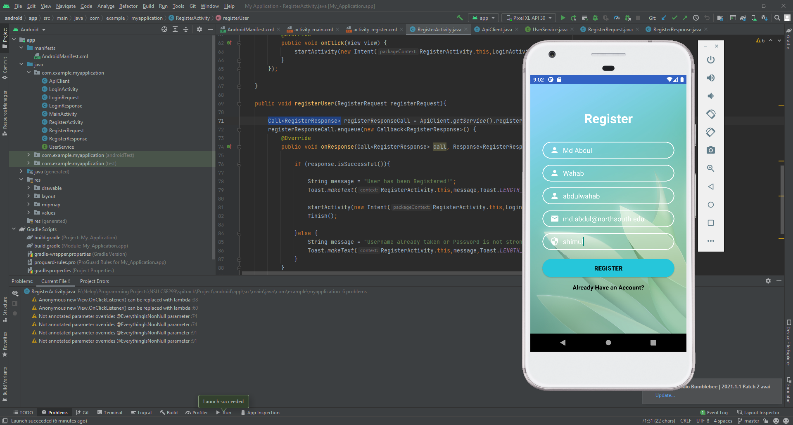
Android Application (Rafid): User Registration (Sign Up)
Name
Email
Username
Password

Slide 20
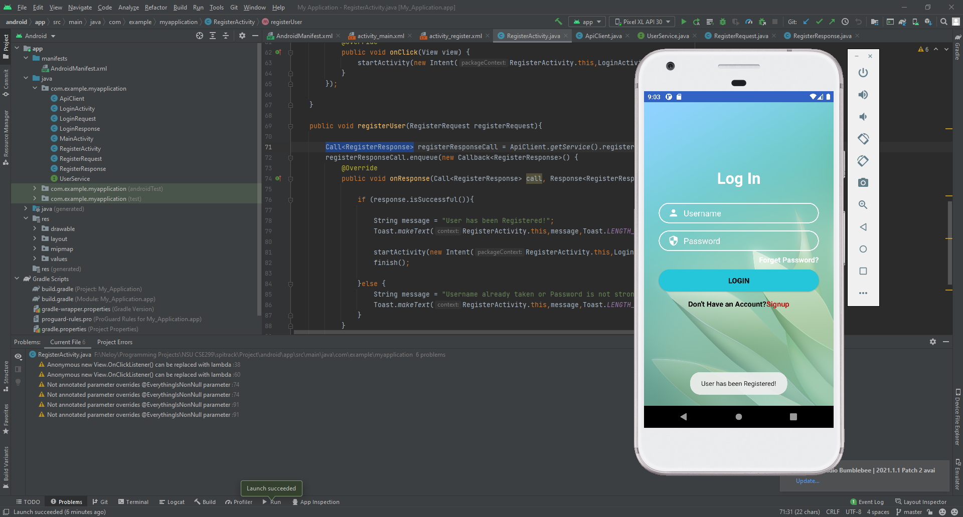
Android Application (Rafid): User Registration Success (Sign Up)

Slide 21
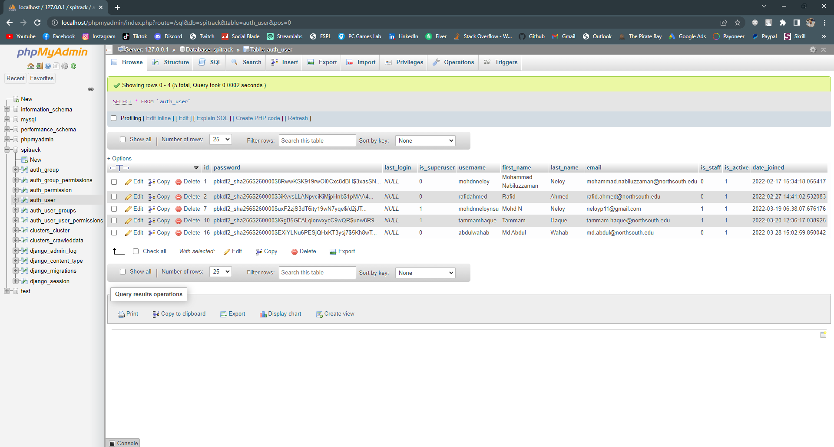
Android Application (Rafid): User Registration Database Update

Slide 22
Thank You!

